Slide 1
Quality Assurance
“A delayed Game is eventually good, but a rushed game is forever bad.” –Shigeru Miyamoto

Slide 2
QA
Quality Assurance – a program for the systematic monitoring and evaluation of the various aspects of a project, service, or facility to ensure that standards of quality are being met.
In the past, programmers would test their code on their own. Now that software and games have increased in complexity, companies may have departments for testing, or outsource to companies dedicated to product testing.

Slide 3
QA
A testing plan should be used to create a consistent testing environment. This plan is a document detailing the objectives, resources, and processes for a specific test.
Testing is broken up into two categories, Validation and Verification.
Validation – ensures the program meets the customer’s requirements by testing predefined tasks.
Verification – ensures the program runs correctly without error.

Slide 4
QA
Testing is used to reveal bugs. A bug is an unexpected result from a program. They are broken up into three categories based on their severity, A, B, and C.
A – These are critical bugs that would prevent shipping the software. These include crashing, hardware failure, or multiple other bugs that prevent the software from reaching the minimum quality accepted for release.
B – The program works, but has issues. These could be a rare save file corruption, side quests that cannot be completed, or incorrect text being displayed.
C – These are small and obscure bugs that do not prevent the game or program from running. This includes graphical bugs, animation bugs, or interface bugs.
https://www.polygon.com/2019/12/13/21020384/the-outer-worlds-companion-bug-dead-qa-taylor-swope-obsidian

Slide 5
QA
Functionality Testing – General testing of the functionality of the program, including game mechanics, graphical bugs, user interfaces, etc.
Performance & Load – Testing the limits of how many objects can be on screen at once, as well as testing to maintain consistent frame rate and quality

Slide 6
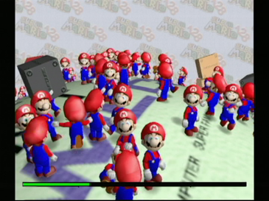
QA
Mario 128 could be an example of a load test for the Game Cube.

Slide 7
QA
Soak Testing – Similar to a load test, a soak test focuses on game performance over extended periods of time. The program is left on to check for memory leaks.
Compatibility Testing – The program is run on multiple combinations of hardware and software to ensure it will run.
Compliance Testing – This tests against the requirements of services, publishers, console manufacturers, and ratings boards.

Slide 8
QA
Combinational Testing – All attributes of variable data and configurations are identified. Once identified, every combination is tested.
Ad Hoc Testing – Testing without a test plan. There is no structure, however, this can find problems that the original test plan may not have covered.
Regression Testing – Once a bug has been fixed, the fix is tested to ensure functionality is not lost.

Slide 9
QA
Play Testing – The process of testing a game to balance the difficulty, flow, and “fun-ness.”
Beta Testing – This is the point where the game is mostly finished and playable. Recently, Beta testing has become public, letting developers collect more information before releasing the game.

Slide 10
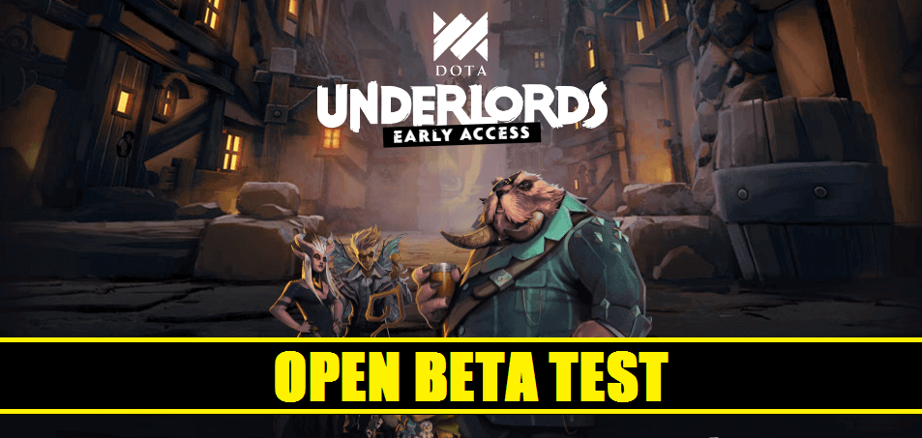
QA

Slide 11
QA
Most methods of testing follow the same process (the exception being Ad Hoc testing).
Identification – discovering incorrect program behavior and labeling it as a bug.
Reporting – The bug is cataloged in a bug tracking system, along with a method of recreating the bug.
Analysis – The bug is inspected by the developer for that portion of the code to find a fix.
Verification – After a bug is fixed, it is tested to ensure it no longer occurs.

Slide 12
QA
Edge Case – a situation that only occurs at an extreme operating parameter. A component on its own may work, but when combined with other components, it may cause an error. For example, if there is a buy one get one free, and a buy 11 get one free sale at a store, and a customer buys 11, what should the result be?
A real world example is a text message that can cause iPhones to crash.

